Slide 1
Control Flow in Programming
Conditionals and Iteration

Slide 2
What did we talk about last week?

Slide 3
Data Types in Python
Last class we talked about integers and floating point (decimal) numbers
Integer: x = 4 Floating Point: y = 6.587
We also saw, but didn’t really talk about strings
String: z = “Hello World!”
print z

Slide 4
New Data Type: Booleans
Booleans are the simplest data type in any language, representing a value that is either True or False
x = True
y = False
We can create new booleans using logical operators
print x and y
print x or y
print not x

Slide 5
Comparison
Comparison operators let us generate boolean values by comparing other values.
We have 6 comparison operators (note the double, rather than single ‘=’ sign):
< , <= , > , >= , ==, !=
an_int = 5
under_four = an_int <= 4

Slide 6
Conditionals
Conditionals let us use booleans to control our program:
def goldilocks(porridge_temp):
“””Very useful classification algorithm”””
if (porridge_temp < 110):
print “Too cold”
elif (porridge_temp > 130):
print “Too hot”
else:
print “Just Right!”

Slide 7
Assignment
We will email you some problems again
Code your solutions

Slide 8
Thoughts on Assignment
What went well?
Do you need clarification on any concepts before we move on?
Any questions / concerns / queries / criticisms / comments / mopes / dopes / etc.?

Slide 9
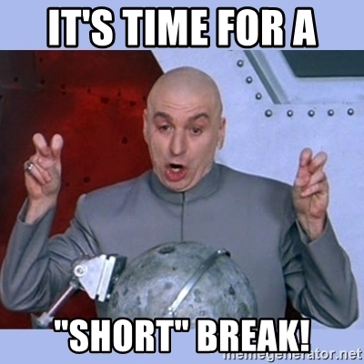
=(
No Chaüs

Slide 10
Limitations of what we know so far
As you have probably noticed, your programs get awkward when you have a bunch of inputs:
def dot_product(x1, y1, z1, x2, y2, z2):
return x1 * x2 + y1 * y2 + z1 * z2
This method is also problematic because it doesn’t allow us to use the same code on different input sizes

Slide 11
Lists
Lists are a way of encapsulating data.
Lists hold other objects.
Similar to a mathematical set, but with a defined order.
Shorthand notation for lists: lst
x = [1, 2, 3]
print x[0] #computer scientists count from 0
print x[1]
print x[2]

Slide 12
Lists (continued)
Lists have a bunch of methods, so read the documentation, but here are a few common cases:
x = [“a” , “b”, “c”, “d”, “e”]
Length of list: print len(x) Max item in list: print max(x)
3rd item in list: print x[2] Last item in list: print x[-1]
“Slice” a list: print x[1:2] Sort a list: x.sort()
print x

Slide 13
Lists (even more continued)
Mutable: meaning we can modify them i.e. add or remove items or modify specific items
x = [ 1, 2, 3, 4, 5]
Add an item: x.append(6) Remove an item: x.pop(3)
Modify an item: x[0] = 7 Copy a list: y = x[:]

Slide 14
Range Function
We can make lists of sequential numbers using the range function:
print range(6)
print range(1, 6)
print range(1, 6, 2)
What do these do? How would we generate [6, 4, 2]?

Slide 15
Strings
We have seen strings a little bit already. It turns out they behave a lot like lists:
str = “hello friends”
print str[0] #prints first term
print str[-1] #prints last term
print str[0:6] #prints first 5 letters
One key difference: strings aren’t mutable
str[0] = “c” #This gives us an error

Slide 16
Iteration
Probably the most important idea in Computer Science
Allows us to run the same block of code many times
Lets you solve many new, interesting problems, including ones that you could not hope to solve before now
Example: How would we do x^{n} without using the exponentiation operator?

Slide 17
Iteration using lists or strings (iterables)
When we want to do something with every item in a list or character in a string, we can use a “for-loop”
def print_list(lst):
“““Print all the items in a list on separate lines”””
for item in lst: #note: item is a variable
print item
Notes:
Talk about use of range here, dummy variables
Explain that for loops go through iterables sequentially
End at end of list

Slide 18
While loops
Used to keep working until some condition is met
While loops will repeat for as long as a condition is met:
counter = 1
while counter < 10:
print counter
counter = counter + 1

Slide 19
Playing with iteration
We now have enough tools to solve some interesting problems.
These problems are complicated enough that they will probably take time to think about before writing code
On paper, write a “recipe” for each problem you are trying to solve. What are your inputs? What are your steps? Write your code after you have a recipe
Notes:
Example for recipe:
Function that generates the first n perfect squares!

Slide 20
Debrief
Quibbles? Inquiries?
If you have the time / inclination, finish the problems you haven’t gotten to yet over the course of the next week

